Slide 1

Institutional presentation

Slide 2
ABOUT US
Centro de Derechos Económicos y Sociales – CDES (Center for Economic and Social Rights, in English) is an organization that defends the living, material and environmental conditions, associated with the exercise of Human Rights.
Since our constitution in 1997, we have accompanied processes of rights reinforcement in the construction of environmental justice and economic justice.
Our work team bases its contents in the social, legal, economic sciences and participatory action-research.

Slide 3
WHAT WE BELIEVE IN
Equality is the horizon, public policy the instrument and structural changes the way.
We seek permanent changes in the legal and economic regime to contribute to the expansion and progressiveness of human rights, including economic, social, cultural, and political rights.
The Sumak Kawsay - Buen Vivir is an authentic construction of the bases to achieve development in harmony with nature and the relationships of dignity between all people.
Social justice proposals and processes must be led with the most marginalized and vulnerable peoples, including indigenous nationalities, afro-descendants and working families.

Slide 4



HISTORICALLY DISADVANTAGED GROUPS
Our emphasis as human rights defenders is on indigenous peoples and afro-descendants, women and working families.
Indigenous peoples
Women
Working families

Slide 5
OUR MANDATE (1)
Regulatory framework (among others)
We follow the mandate established in the international human rights instruments and other documents "under construction" that serve as a guide for our constituent processes.
ESC rights
International Covenant on Economic, Social and Cultural Rights
Autonomy y plurinacionality
Declaration of the rights of Indigenous peoples
Human Rights are indivisible and interdependent
Tax justice, debt, trade
Guiding Principles Relating to Evaluations of the Effects of Economic Reforms on Human Rights
Collective rights
Declaration on the right to development
Transnationals and extractive industries
United Nations Binding Treaty for Transnational Corporations on Human Rights

Slide 6
OUR MANDATE (2)
Economic, social, cultural and environmental rights are individual and collective rights.
Individual: the right to decent work, social security, food, housing, health, education and the right to participate in the cultural life of the community and universal scientific advances.
Collective: rights of indigenous peoples, right to self-determination, rights of peoples to dispose of their natural resources, right to development, right to sexual orientation.

Slide 7
WORK METHOD
Knowledge
Participation
Monitor compliance with ESCR
Generate information
Advocacy proposal
Advocacy
Strengthen defenders
Reach mass media and social networks
Articulate with academia
National system: legislative and judicial
International Human Rights System
Participation in multilateral organizations

Slide 8
SCENARIOS
FMI / DEUDA
Decent work
ACM UE
Decent work
Enviromental rights
PEOPLES
Women
Health, education, social equality
Indigenous peoples
working families
Labour reform
Tax reform, FFI
Financial reform
Labour reform
Enviromental reform
Commercial policy
Labour reform
Tax reform
Enviromental reform
Impact of public policy on human rights
Women, indigenous peoples, afro-descendants
Impoverished working families

Slide 9
INTERNATIONAL SCENARIOS
LATINDADD / Tax Justice Network
Debt Group, Tax and FFI
Red - ESC rights
Moterrey + 20
Latin American Extractive Industries Network
C20, UNCTAD XV, CEPAL, ECOSOC, OECD, FACTI
CIDH, NN.UU. (special mechanisms)
Andean Internal Advisory Councils - European Union
Panamazonic Social Forum, COICA
Public Services International, Americas Central Trade Union (CSA/CSI)

Slide 10
LINES OF ACTION
Decent work
Tax justice
Debt & Human rights
Indigenous peoples

Slide 11

LINES OF ACTION
Decent work
Tax justice
Debt & Human rights
Indigenous peoples
We monitor labor policy. We support unions and
rural workers. We report ways
contemporary slavery. We look for alternatives
to the IMF labor reform. We monitor the
labor clauses of the Trade Agreement with the European Union
https://www.furukawanuncamas.org

Slide 12
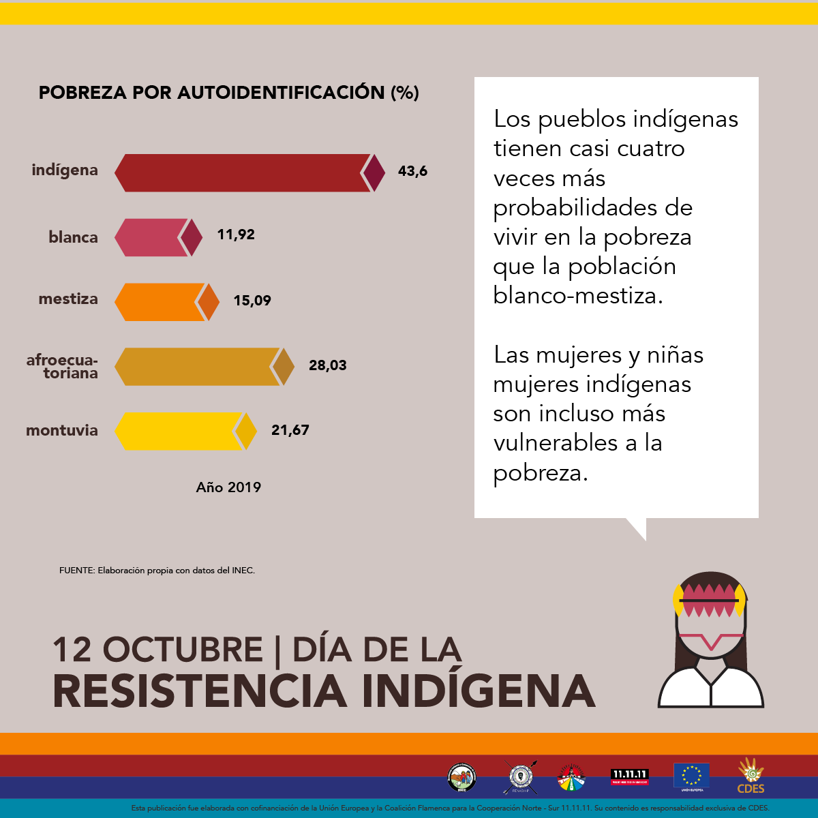
LINES OF ACTION
Decent work
Tax justice
Debt & Human rights
Indigenous peoples
We promote a citizen oversight of the foreign debt.
We assess the impact of debt on
economic and social rights.
We strengthen proposals for action from civil society.
https://cdes.org.ec/web/?p=6137

Slide 13

LINES OF ACTION
Decent work
Tax justice
Debt & Human rights
Indigenous peoples
We promote the political and civil rights of women.
Sexual and reproductive rights.
Economic and social rights.
We develop training schools.
https://veeduriadeudaecuador.wordpress.com

Slide 14
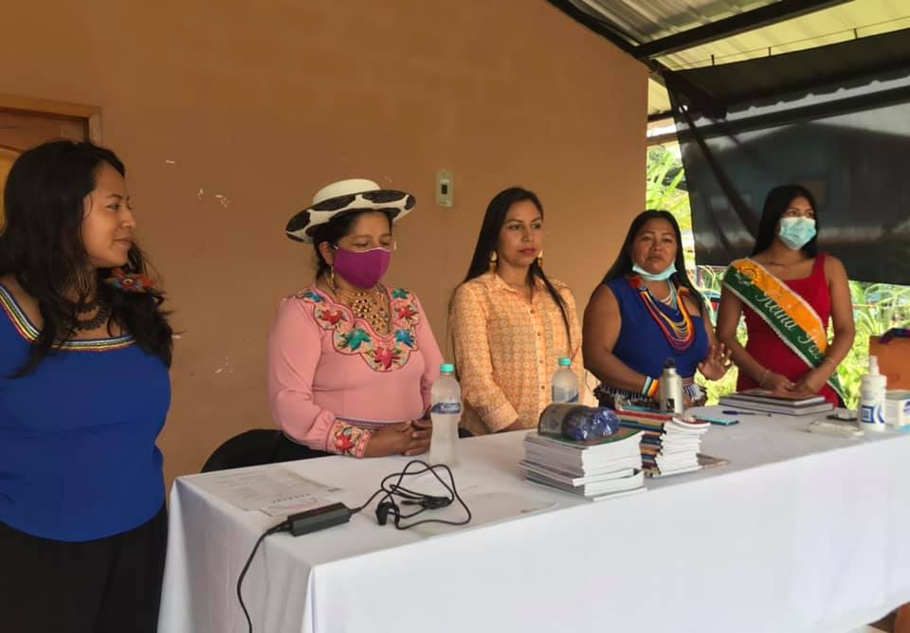
LINES OF ACTION
Decent work
Tax justice
Debt & Human rights
Indigenous peoples
We promote the political and civil rights of women.
Sexual and reproductive rights.
Economic and social rights.
We develop training schools.

Slide 15
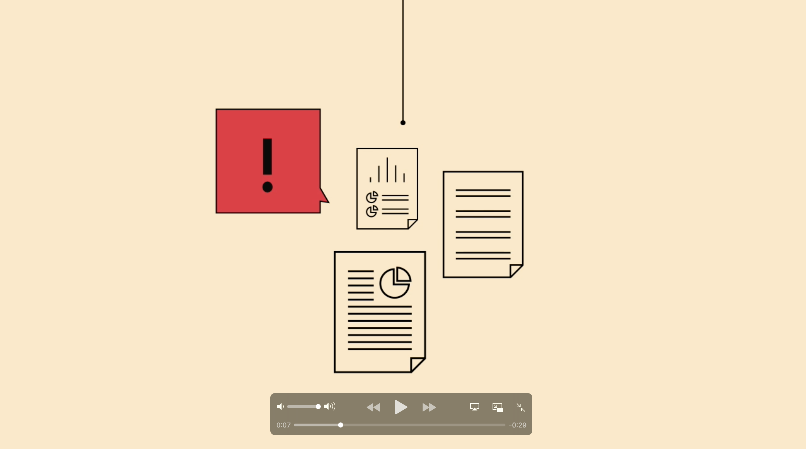
CAMPAIGNS
Impact in news
Mass Media
Viral debate
Social media
Assembly, Government, Courts of Justice
Authorities
Click to see video

Slide 16
THANKS!
CENTRO DE DERECHOS ECONÓMICOS Y SOCIALES - CDES
Quito – Ecuador
El Día N37 48 y El Comercio, Edificio Ateneo, Oficina 101
cdes.org.ec | @cdesecuador

